Slide 1
Closing the loop for aluminium beverage cans
Claudia Bierth, European Public Affairs & Sustainability Manager, Ball Beverage Packaging EMEA
Alexander Kuzan, Vice President Can, Novelis Europe
Dusseldorf, 28th September 2022
Notes:
Introduction Claudia

Slide 2
Our Ambition
$17.1B
Annual revenue
4,080 kt
Annual shipments
Novelis’ ambition is to be the world’s leading provider of low-carbon, sustainable aluminum solutions that advance our business, industry, and society toward the benefits of a circular economy.
9
Countries
12,690 Employees
33
Manufacturing locations
Figures from Fiscal Year 2022
1
Notes:
Novelis has a strong ambition
We aim to be the leading provider of low-carbon, sustainable aluminium solutions
That advances our business, industry and society toward the benefits of a circular economy.
Novelis already is a world leader in aluminium rolling and can rely on it´s strong market presence
What sets us apart is a global footprint – with 33 manufacturing locations across 9 countries and a strong performance record
We provide superiore quality, innovative, low-carbon aluminium to a global market
Last fiscal year we supplied 4,080kt aluminium products to our customers…

Slide 3
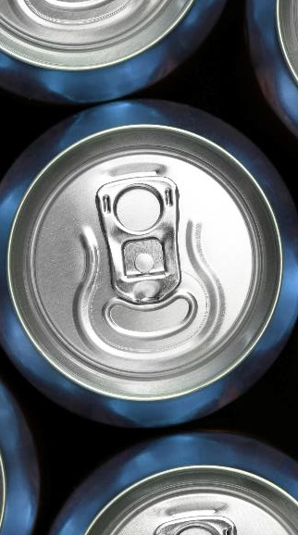
Our Ambition
Novelis’ ambition is to be the world’s leading provider of low-carbon, sustainable aluminum solutions that advance our business, industry, and society toward the benefits of a circular economy.
Can
51%
Specialties
27%
Automotive
19%
Aerospace & Industrial Plate
3%
Novelis market supply in Fiscal Year 2022
2
Notes:
…in the Can, Specialties, Automotive and Aerospace industry
More than half of the shipments in FY2022 have been supplied to can customers
We are a reliable and strong partner for our customers
[As we are for Ball; as the largest producer of aluminium beverage can sheet]

Slide 4
Our Recycling
Leadership
57 % recycled content across product range
>80B used beverage cans recycled annually
>$1.1B invested in recycling capacities & capabilities since 2011
Figures from Fiscal Year 2022
3
Notes:
Moreover, Novelis is the world´s largest recycler of aluminium
We recycle more aluminum than anyone in the world – 2.2 million tonnes per year.
Just speaking of used beverage cans – Novelis recycles more than 80B UBCs per year
Sustainability is at our core – we made this the center of our business strategy over 11 years ago
Since then we have invested more than $1.1B in recycling
which helped us achieving an average RC of 57% across our product range
Our aim is to achieve a fully circular economy by partnering with our suppliers, as well as our customers
[a great success story to tell is our strong partnership with Ball and our joint commitment to circularity]
[Our focus on recycling drives us constantly forward to advance on our purpose of „Shaping a Sustainable World Together“]
--------------------------------------------------------------------------

Slide 5
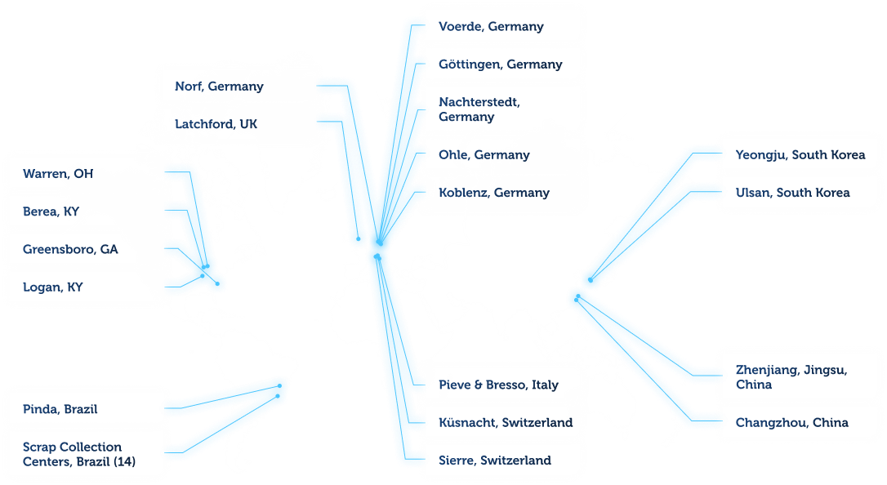
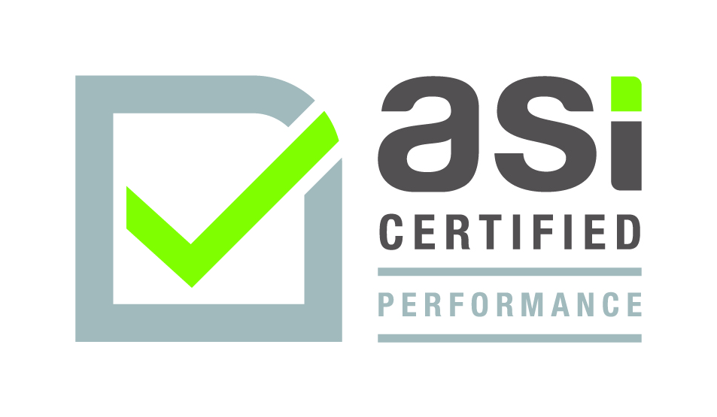
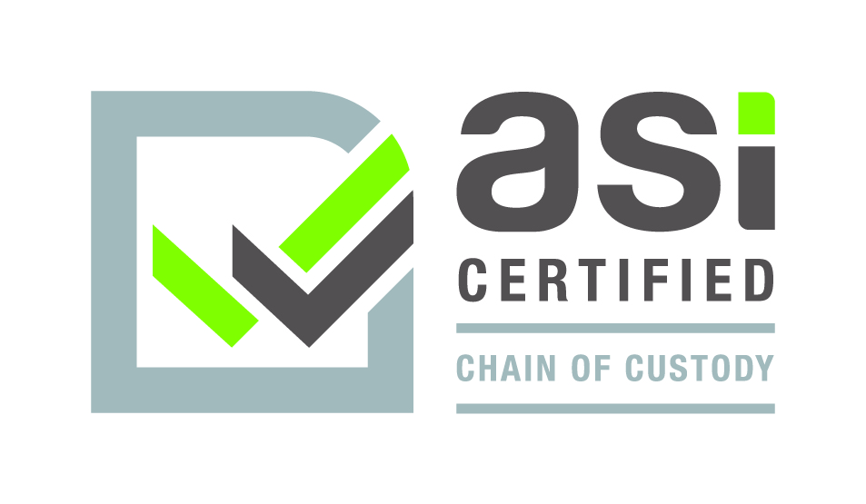
Aluminium Stewardship Initiative
Certifications
ASI Performance Standard: Korea, Europe, North America, South America
ASI Chain of Custody: Europe, Korea
4
Notes:
Another proof point for Novelis being a frontrunner in sustainability:
We support the Aluminium Stewardship Initiative - to maximize the contribution of aluminium to a sustainable future
By fostering responsible production, sourcing and stewardship of aluminium through the entire value chain
Novelis currently has 18 ASI-certified plants in Europe, North America South America and Asia, and is actively pursuing ASI certifications for further Novelis plants across the globe
All of Novelis’ 10 manufacturing and recycling sites in Europe have achieved ASI Certifications for both Performance and Chain of Custody standards in 2021.

Slide 6
The melding of packaging, aerospace and pride
2021
2021
2021
2021
11.4B
$1.9B
$0.5B
$13.8B
BEVERAGE
PACKAGING
SALES
AEROSPACE
SALES
AEROSOL
PRODUCTS
SALES
NET
SALES
Founded: 1880
Employees: 24 300
Headquarters: Westminster, CO USA
5
Notes:
Ball Beverage Packaging is the largest beverage can manufacturer worldwide. It is subsidiary of Ball Corporation which supplies aluminum packaging solutions to beverage, personal care and household customers as well aerospace technology.

Slide 7
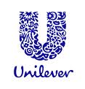
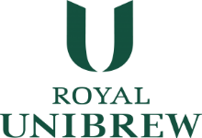
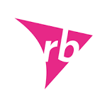
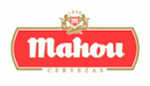
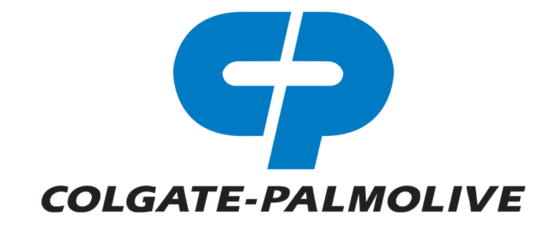
GLOBAL CUSTOMERS Put their trust and products in ours
6
Notes:
Here you see a selection of our customers across the 3 business units

Slide 8
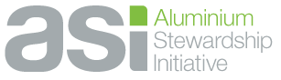
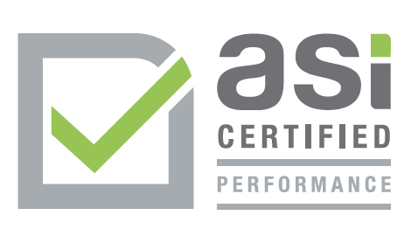
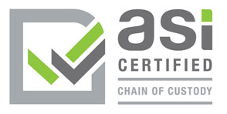
ALL BALL Global Beverage PLANTS ASI-CERTIFIED
Notes:
Ball was the first beverage can producer who certified all its global beverage plants to the Aluminium Stewardship Initiative, starting with the EMEA region in 2019, until 2030 we want to have all our other business operations certified as well.

Slide 9
Notes:
Run video
Long-standing partnership with Ball
Joint efforts to increase the recycling of aluminum beverage packaging
Established closed-loop recycling systems & increasing RC%
[USA: Ball Corporation and Novelis increased recycled Content of the Ball Aluminium Cup to 90%]
Transition Claudia to next slide

Slide 10
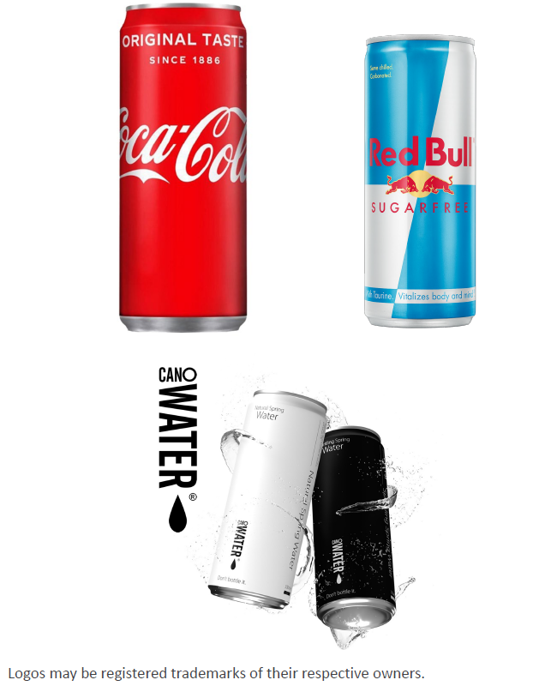
The Alu Beverage Can Market keeps Growing - 2022-2027
~4-6% volume growth*
Package mix shift to aluminum cans versus other substrates
Customers adding 130 can filling lines (2020-2024)
New product launches in core categories
Ongoing favorable mix shift in carbonated soft drinks
Advanced sustainability & packaging policies
Continued strength in energy drinks and carbonated soft drinks categories
Cans resilient in current economic climate
* Given current macro environment, near-term volumes may be lower
9

Slide 11
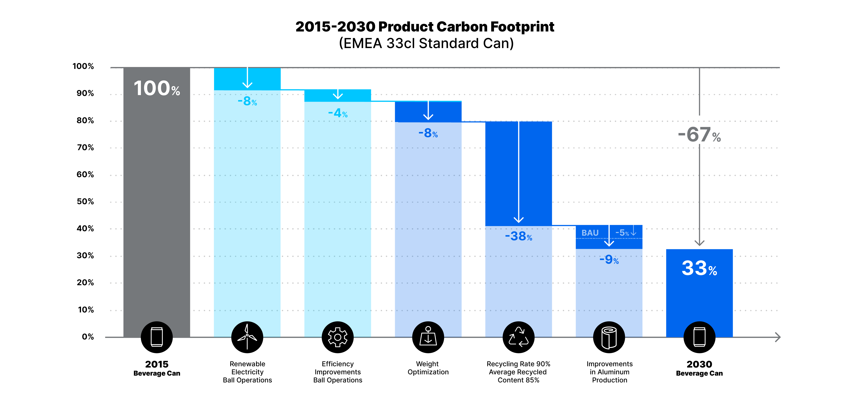
Potential European Beverage Can Carbon Footprint reduction Pathway (2015-2030, cut-off Approach)
10
Notes:
And as you can see
Given the current European security and energy crises we need a new approach maximising both energy and resource efficiency with the same level of importance.
see from our can carbon footprint reduction roadmap for Europe, the biggest lever for us are increasing recycling rates and recycled content
The biggest lever for carbon footprint reduction is increasing Recycling Rates and Recycled content
[Following slide++, Claudia will highlight the importance of increasing RR; the slide++ after that, Alex will highlight the importance of increasing RC]

Slide 12
With closed-loop recycling, materials are recycled back to the same application, and this could be done for multiple cycles
NUMBER OF PACKAGING UNITS THAT CAN BE MADE OF RECYCLED MATERIALS BEFORE THE MATERIAL IS DEPLETED
Each packaging unit placed on the market could be transformed into 9 new units in a close-loop scenario before the material is depleted
NUMBER OF PACKAGING UNITS MADE OF RECYCLED MATERIALS BEFORE THE MATERIAL IS DEPLETED
9
=
+0.9+0.8+0.7+0.7+0.6+0.5+0.5+0.4+0.4+0.3+3.1
NEW UNITS MADE OF RECYCLED MATERIALS
RECYCLING RATE
⬅ 1 PACKAGING UNIT
11
Notes:
What is really important to understand is the potential of closed loop recycling to produce extra product units in multiple recycling, this grows exponentially the higher the recycling rate is
When placing 1 packaging container on the market, depending on the collection and recycling process, the amount of material that is captured and subsequently recycled varies significantly.
Say a separate collection system is implemented, with a capture rate of 90%. This would mean that out of 1 kg of container, 0,9kg are captured. Assuming a 100% perfect recycling yield, these 0,9kg would be recycled into 0,9 kg of container again. It would then re-enter the market, and go through the same process.
After the second cycle, 0,81 kg would have been captured (0,9 * 0,9), and recycled into 0,81 kg available for a new life. Etc, etc… After several more iterations, using an original input of 1kg containers, you would have produced +0.9+0.8+0.7+0.7+0.6+0.5+…=9 kg recycled container material before the material is depleted.

Slide 13
High collection rates for beverage cans boost the ‘reuse’ of packaging material in a closed-loop scenario
COLLECTION RATE
NUMBER OF PACKAGING UNITS THAT CAN BE MADE OF RECYCLED MATERIAL FROM ONE PACKAGING UNIT PUT ON THE MARKET
2.5
Each can POM could be transformed into 2.5 new cans in a can-to-can scenario before the material is depleted
76%
NEW
UNITS
ALUMINIUM
CANS
2019 UE average recycling rate
14.5
99%
NEW
UNITS
Best case DRS scenario
5.7
90%
NEW
UNITS
2030 Ball
ambition
12
Source: Collection rates >> MPE & European Aluminium, 2021 (2019 data), recycling yield 94%
Notes:
Here you can see the differences in the number of can units that can be made of recycled material from one can put on the market – depending on the recycling rate
In Europe, with an average recycling rate of 76%, these are 2.5 new cans
In Germany, wiht the highest beverage can recycling rate in the world of 99%, it would be 14.5 units
With Ball‘s global 2030 target of 90% recycling rate, it would be still 5.7. new units

Slide 14
Aluminium Production Carbon Footprint & Energy Consumption
t CO₂eq/t Al
200
150
100
50
0
GJ/ tAl
Carbon Footprint
Energy Consumption
Source: Life cycle inventory data and environmental metrics for the primary aluminium industry, World Aluminium, 2015. Addendum, August 2018 // Environmental Profile Report 2018, European Aluminium
Notes:
Focus RC% as a lever for decarbonization
---------------------------------------------------
Increasing RC % in products drastically lowers their carbon footprint
Recycling is the true pathway to decarbonization
The global average for the carbon footprint of primary aluminium is around 17 t CO2eq/t Al
Low carbon primary aluminium, based on CO2-free electricity for the smelting process (4-4.5 t CO2eq/t Al), reduces CO2 emissions by around 80 % compared to coal-based primary aluminium production (~20 t CO2eq / t Al).
But still, the lowest carbon aluminium is recycled aluminium, with only 0.5 t CO2-eq/t Al for the recycling process.
And – to give the full picture on the benefits of recycling:
Recycling aluminum, saves around 95 % of energy compared to the production of primary aluminum [160 GJ/t Al vs. 8.5 GJ/t Al]. In times like today, where we all have to save as much energy as possible, recycling aluminum is thus even more important than ever.
Low carbon primary aluminium saves carbon emissions but still requires as much energy as coal-based primary aluminium. Decarbonizing electricity does not per se reduce the amount of energy required for producing primary aluminium.
At Novelis we are building on recycling as the key lever for reducing not only the carbon footprint, but also the energy intensity of our material.
Recycling is the most energy efficient process for aluminium production and emits the least carbon.
---------------------------------------------------------------------------------------------------------------------------------------------------------------------------
BACKGROUND INFORMATION
If a plant switches from fossil fuel to renewable energy --> no impact on the energy consumption.
Decarbonizing electricity for the electrolysis does not per se reduce the amount of energy required for producing primary aluminium.

Slide 15
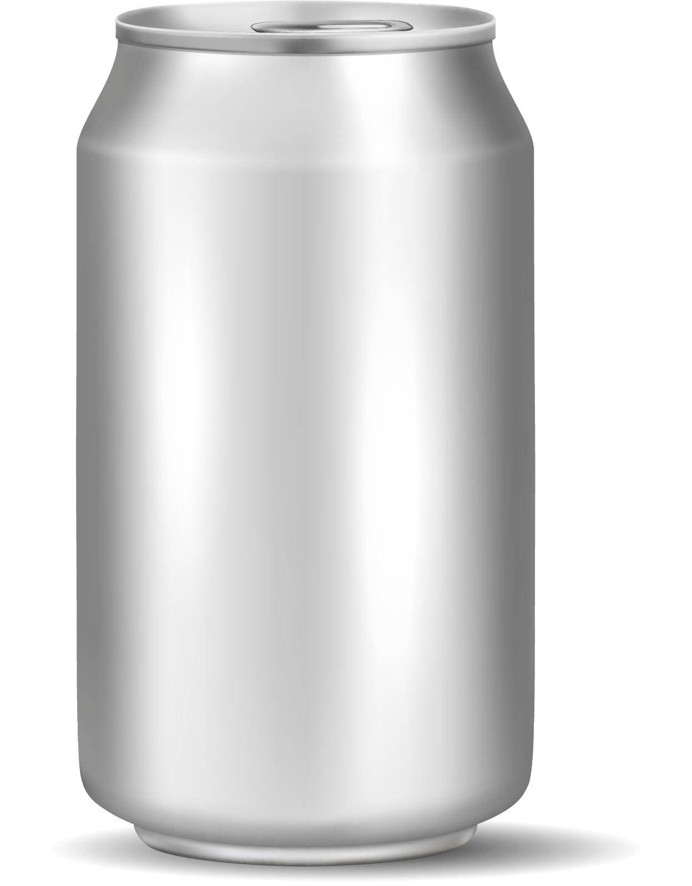
Towards 100% Recycled Content
Weight
in g
Carbon Footprint
in t CO2eq / t Al
0.5
7.6
~78%
RECYCLED
CONTENT
2.0
7.6
10.0
2.6
Novelis can sheet today
Ø 3.6
Source: Recycling content and CO2 emissions according to Novelis Europe Can CY21 production; assuming upgauging to 0.230 and 0.33cl sleek; estimates for future can based on technical feasibility data and environmental metrics for the primary aluminium industry, World Aluminium, 2015. Addendum, August 2018 // Environmental Profile Report 2018, European Aluminium
Notes:
Therefore, we work towards 100% RC
We already are the frontrunner in producing low carbon aluminium sheet
NE aluminium sheet is made out of around 75% RC (CBS, CES, CTS)
Our ambition for the next less than 10 years will be to deliver material that will enable our can customers to produce cans made of almost 100% RC
The game changer will be to use an uni-alloy for CES and CBS → and of course a high recycled one.
Take a look a the current can with CES at 2g / 7.6 tCO2eq/tAl and CBS at 10g / 2.6 tCO2eq/tAl.

Slide 16
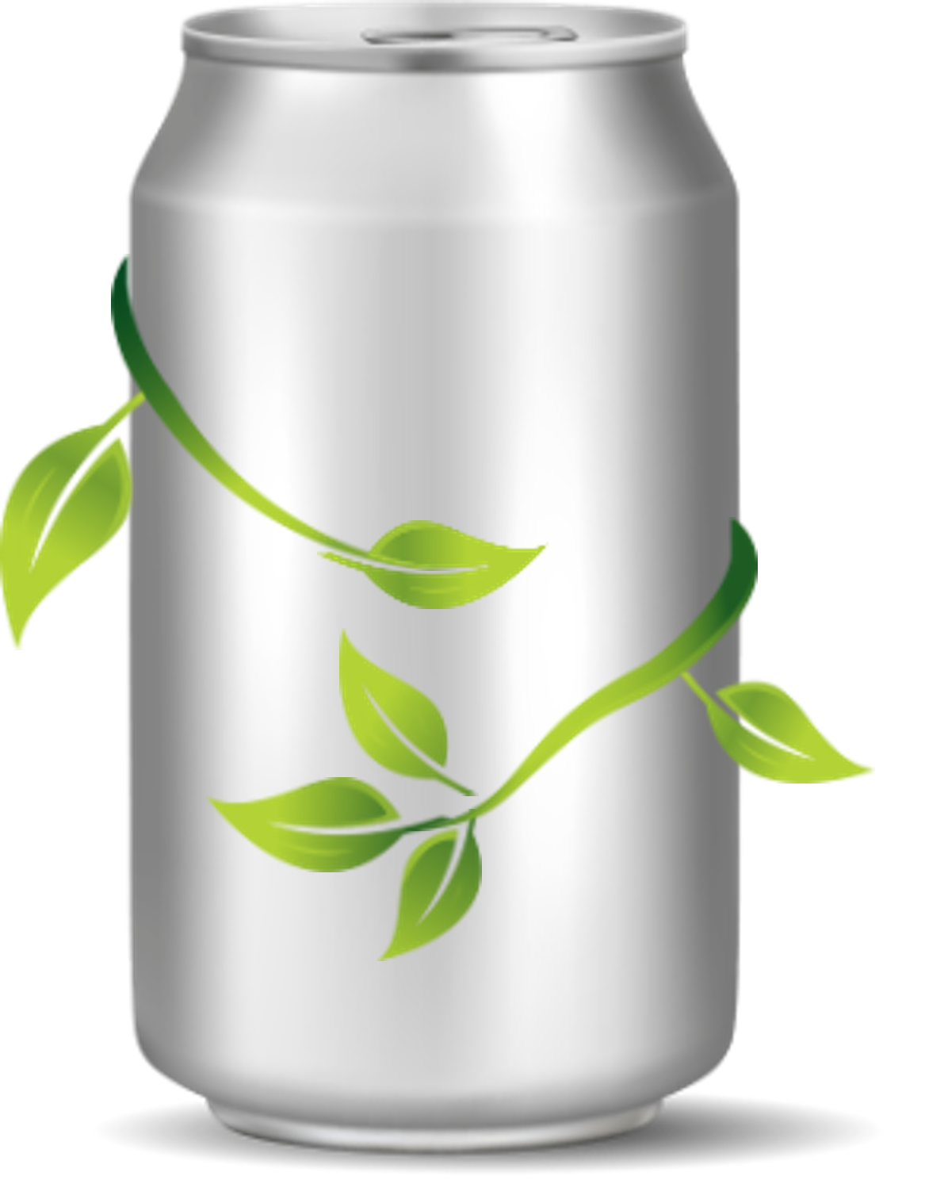
Towards 100% Recycled Content
Weight
in g
Carbon Footprint
in t CO2eq / t Al
0.5
7.6
>95%
RECYCLED
CONTENT
2.3
1.3
10.0
1.3
Ø 1.5
Potential 2030
Source: Recycling content and CO2 emissions according to Novelis Europe Can CY21 production; assuming upgauging to 0.230 and 0.33cl sleek; estimates for future can based on technical feasibility data and environmental metrics for the primary aluminium industry, World Aluminium, 2015. Addendum, August 2018 // Environmental Profile Report 2018, European Aluminium
Notes:
With an HRC uni-alloy for CES and CBS we can lift the RC% extensively
The material for producing a can will overall contain more than 95% RC
And the best thing?
By slightly increasing the weight of a can – this will more than halving it´s carbon footprint

Slide 17
Towards 100% Recycled Content
~78%
RECYCLED
CONTENT
>95%
RECYCLED
CONTENT
Carbon
Footprint
Reduction
>50 %
Novelis can sheet today
Potential 2030
Source: Recycling content and CO2 emissions according to Novelis Europe Can CY21 production; assuming upgauging to 0.230 and 0.33cl sleek; estimates for future can based on technical feasibility data and environmental metrics for the primary aluminium industry, World Aluminium, 2015. Addendum, August 2018 // Environmental Profile Report 2018, European Aluminium
Notes:
…will more than halving it´s carbon footprint
[The beverage can industry used to optimize the carbon footprint of their products by reducing weight. Today we know that the game changer is about using a material as low carbon as possible].
[This is the concept of uni-alloy that we are currently working on industry level].

Slide 18
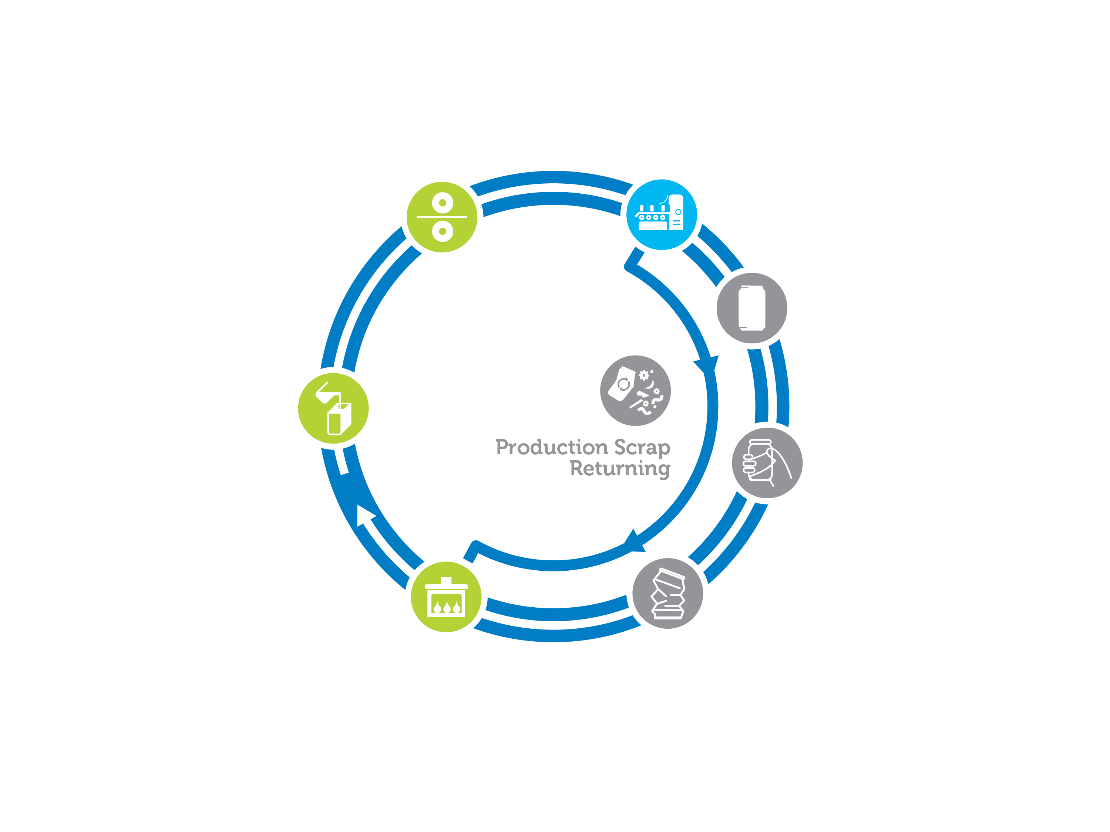
Closed-Loop / Can-to-Can
Recycling
Notes:
To achieve this vision, there are a couple of to-dos within our business but also in collaboration with our customers and partner as well as for the government.
First: our own operations - creating new alloys
Enhance R&D activities & collaborations for material innovation
New scrap segregation technologies
In general, support low carbon and low energy production processes.
Second: close cooperations with our customers, such as Ball
Commitment to develop closed-loop recycling systems and increase the consumption of EOL scrap.
Joint effort to design high recycled content alloys
[and to enhance the use of uni-alloys that will help to increase efficiency in recycling, enable a higher recycled content and preserve the alloying elements]
Advocate for an enabling political framework
To incentivize circular product systems
Set minimum thresholds of RC
And to increase recycling rates
→ an ambition we share with Ball

Slide 19
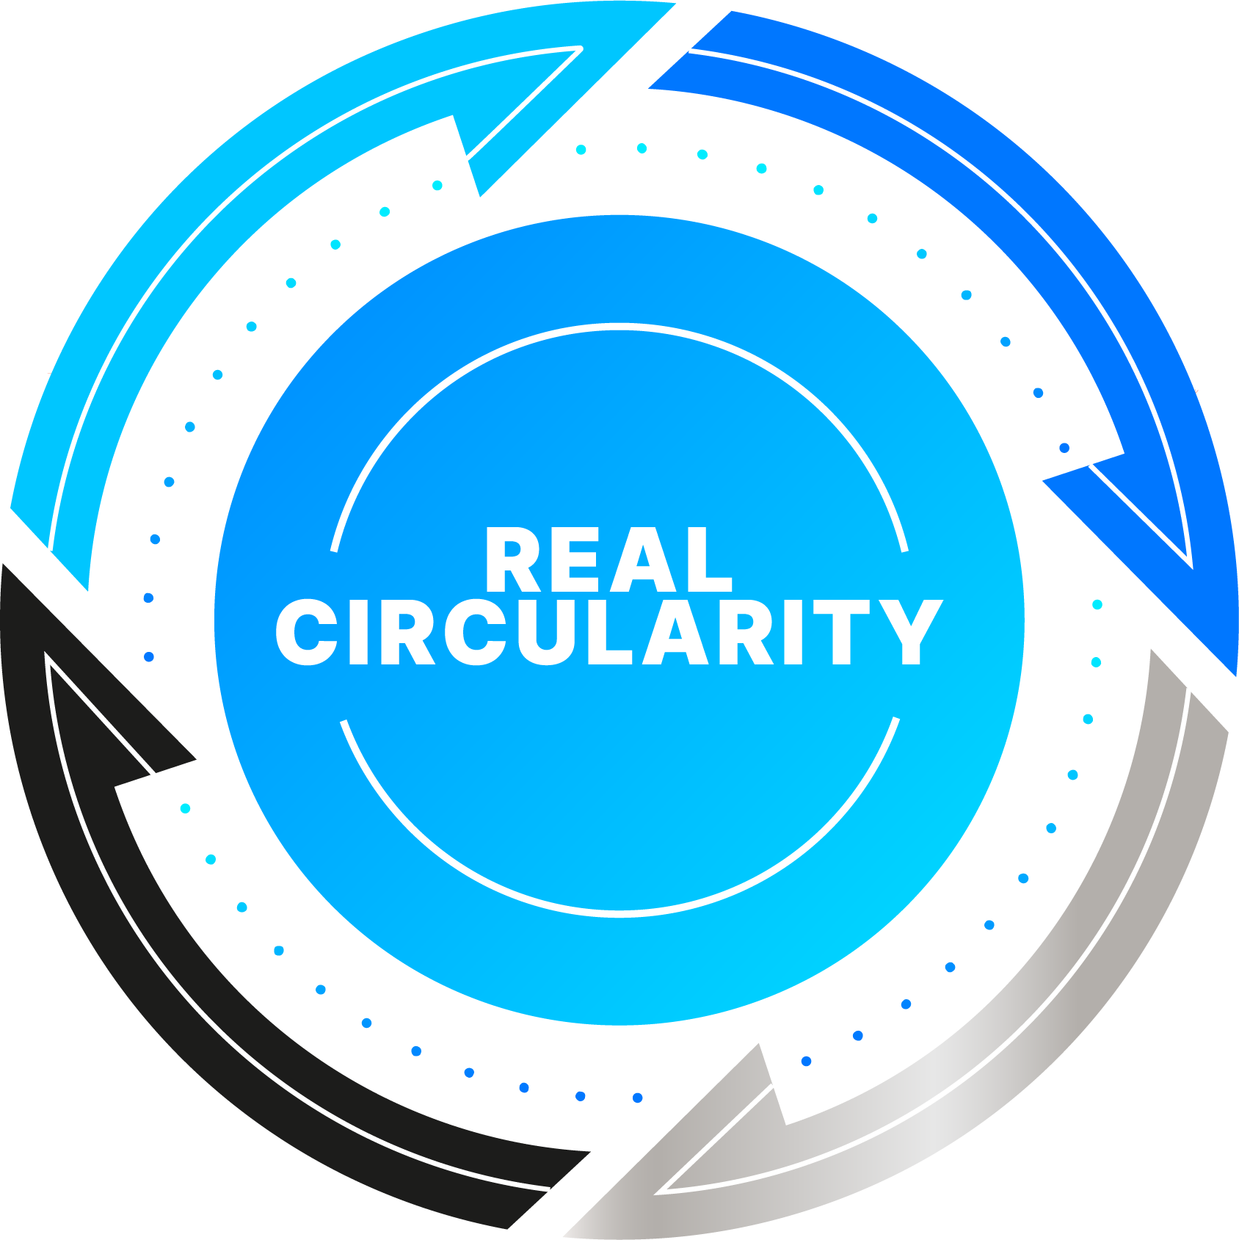
REAL CIRCULARITY Vision: A CIRCLE THAT NEVER ENDS
1
2
100% COLLECTION
100% SORTING
EPR with modulated fees
Deposit Return Systems (DRS)
Set a 90% recovery target for all beverage containers
Convenient for consumers including on-the-go collection
Product design guidelines
Right tipping fees & Material landfill bans
Remove barriers for investments in MRFs and novel sorting technologies
4
3
100% RECYCLED CONTENT
100% RECYCLING
Standard for Recycled Content
Incentives to keep packaging to packaging closed loops
Tax incentives for recycled materials vs virgin
New recycling technologies with maximum yields and quality
Increase local recycling to reduce imports of virgin raw materials
18
Notes:
These are the key policies and tools to move towards real circularity and closing the loop:
Starting with collection: deposit return schemes and setting 90% separate collection goals for all beverage packaging
Banning landfilling
Maximizing recycling yields and quality with state of the art recycling technologies
Incentivize closed loops and recycled materials vs. Virgin material
Increasing and improving closed-loop recycling and developing a more material-efficient value chain will be essential to enable further aluminium beverage can growth, help with energy and material supply issues, and significantly reduce carbon.

Slide 20
Thank you.

